Slide 1

Solving inverse problems in crystal plasticity with differentiable programming
Fanglei Huª, Stephen Niezgoda^{b}, Tianju Xueª, Jian Caoª
a Department of Mechanical Engineering, Northwestern University
b Department of Materials Science and Engineering, The Ohio State University
Notes:
226 - Machine Learning-Based Modeling, Prediction, and Optimization in Advanced Manufacturing and Multiphysical Properties of Materials,
Zhongshu Ren, Qingchang Liu, Zhengtao Gan, Moon-ki Choi, Yue Zhang, Sourav Saha, Yu Pan, Ning Liu (https://drive.google.com/file/d/1W4XtIu279xSLR362QAhvYZVKDWgJyHDh/view)
Thank you very much for the opportunity for giving this keynote talk and summarize my recent work and my collaborators’ work for the past two years. The motivation of this work is following, you know, material properties is very microstructure-driven. And the common practice is look at the microstructure and try to predict property, right?
Now we can ask a question

Slide 2
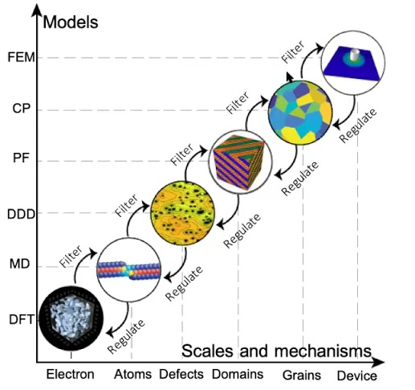


Motivation
Forward Mode [1]
ICME
Input Parameters
Oriented Properties
$$X=[x]$$
$$Y=f[x]$$
Initial blank geometry
Initial microstructure
Manufacturing process
…
Mechanical Properties
Desired microstructure
…
Goal-Oriented Inverse Design
Gradient-Based Optimization
Model
Sensitivity Analysis
[1] Kaushik Bhattacharya, Learning based multi-scale modeling
Notes:
## Integrated Computational Materials Engineering (ICME)
Here is where the forward simulation comes in. However, for smart manufacturing, what we really care about is the property. So can we actually use inverse design to design materials microstructure and/or processing path to get the property.
In this talk, the content of Inverse design means, I have a target property or several target properties as input to derive the initial blank geometry, initial microstructure, and subsequent manufacturing process parameters.

Slide 3
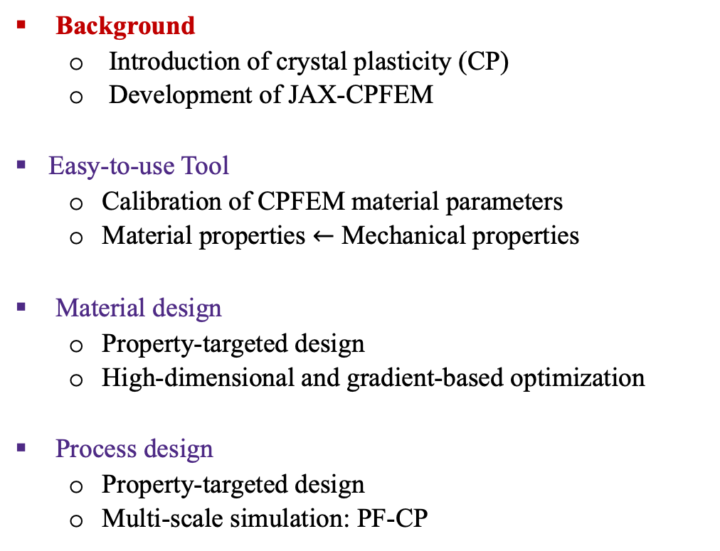
Outline
Background
Introduction of crystal plasticity (CP)
Development of JAX-CPFEM
Easy-to-use Tool
Calibration of CPFEM material parameters
Material properties $←$ Mechanical properties
Material design
Property-targeted design
High-dimensional and gradient-based optimization
Process design
Property-targeted design
Multi-scale simulation: PF-CP
Calibration
Differentiable
Tool
Material
Design
Process
Design
Notes:
## Integrated Computational Materials Engineering (ICME)
Talke more examp.
Box

Slide 4
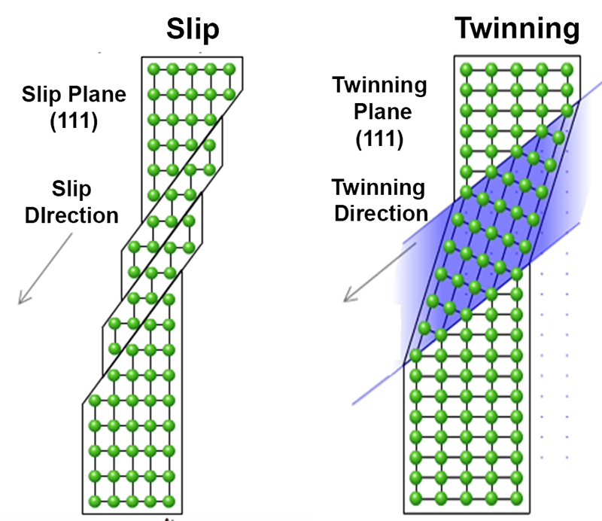
Crystal plasticity
Plastic Deformation
Dislocations glide
Crystal planes
Twinning plane
A mirror image
Cartoon of slip and twinning deformations in a face-centered cubic (FCC) crystal [1]
[1] F. Zhao et al., Physical Review Letter, 116, 075501 (2016)
Notes:
### Introduction of CP
Undeformed grain

Slide 5
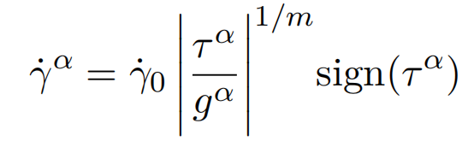
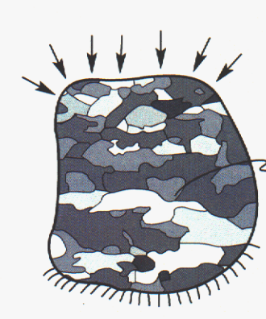
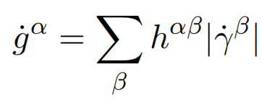
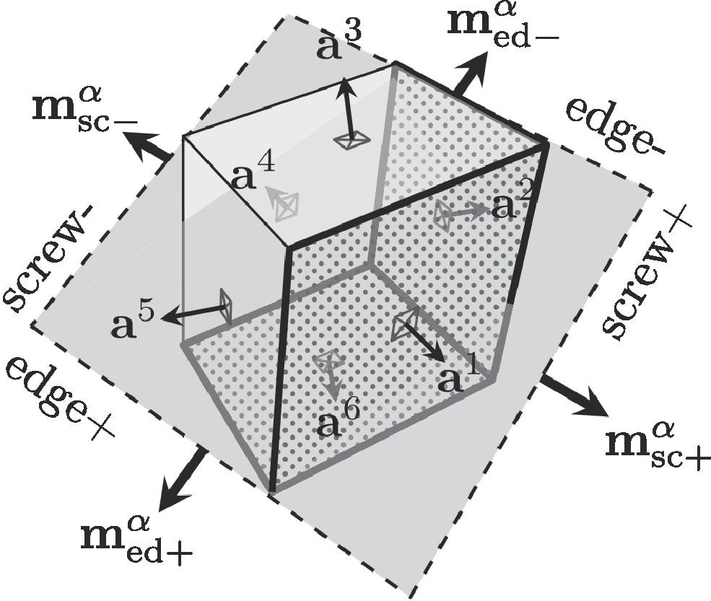
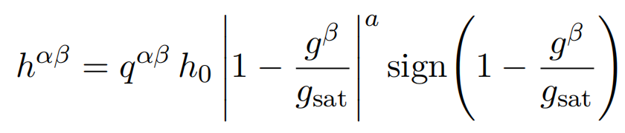
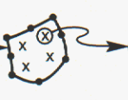
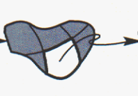
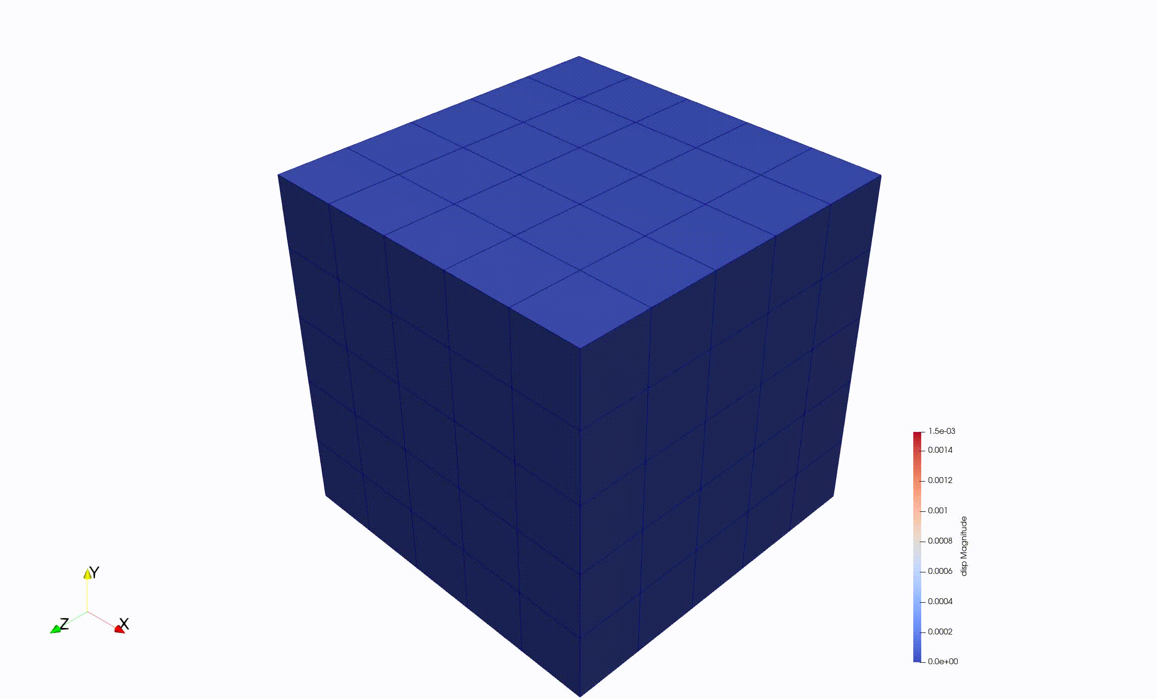
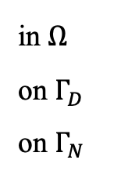
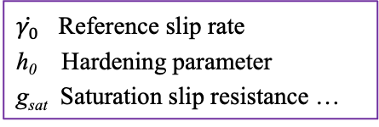
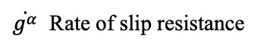
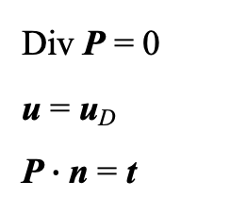
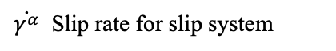
Crystal plasticity finite element method (CPFEM)
Kalidindi’s self and latent hardening law
$\dot{γ^{α}}$ Slip rate for slip system
$\dot{g^{α}}$ Rate of slip resistance
$\dot{γ_{0}}$ Reference slip rate
h₀ Hardening parameter
g_{sat} Saturation slip resistance …
Slip / Twinning Modes
Finite Element Method
Crystal Plasticity FEM
Constitutive Models [1]
Momentum Balance Laws [2]
Div P = 0
u = u_{D}
P$∙$n = t
in $Ω$
on $Γ_{D}$
on $Γ_{N}$
Self-hardening laws
Self and latent hardening laws
[010]
[001]
[100]
[1] Roters, F. et al., Computational Materials Science, 2019. 158: p. 420-478.
[2] Marin, E.B., 2006, Sandia National Laboratories, Albuquerque, NM, and Livermore, CA
Notes:
### Introduction of CPFEM
Note: single crystal Ta under compression (Mesh: 5x5x5)
Backup 1: Kalidindi’s constitutive law P34

Slide 6



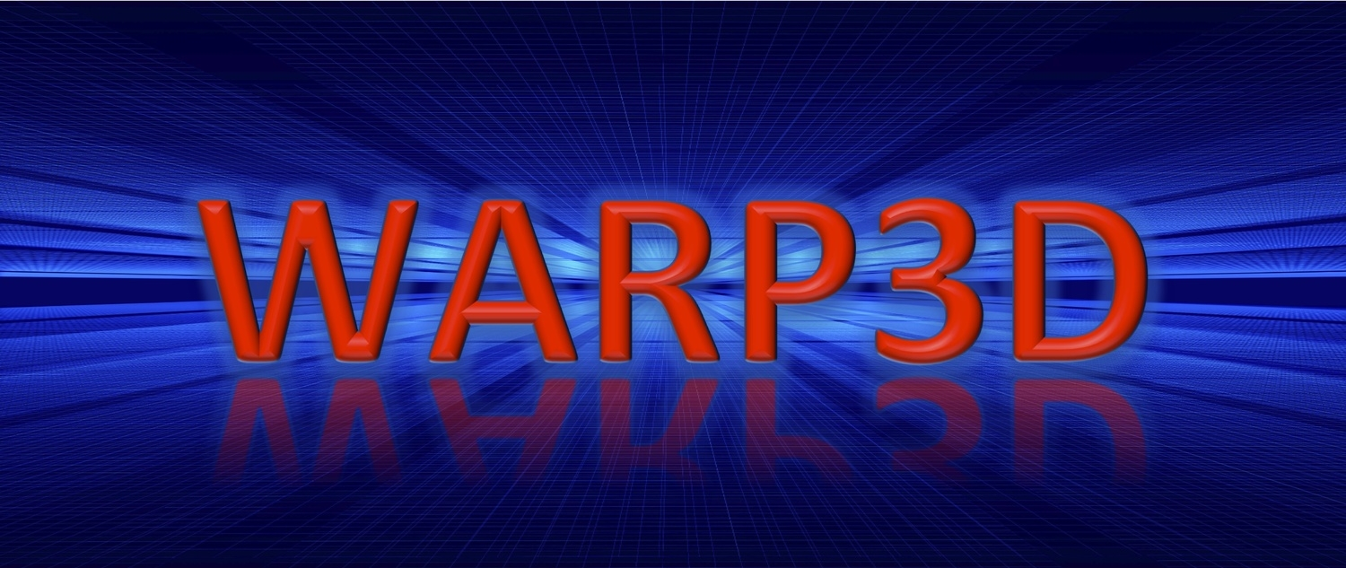



Tools
Let’s go open-sourcing!
Can we design a generic CPFEM software:
Easy-to-use
Affordable
Modular code
AutoDiff of constitutive law
GPU-accelerated
Differentiable
Popular commercial software
Existing open-source software
$$$
For-loops & MPI
Notes:
Font-size
WARP3D → UIUC

Slide 7


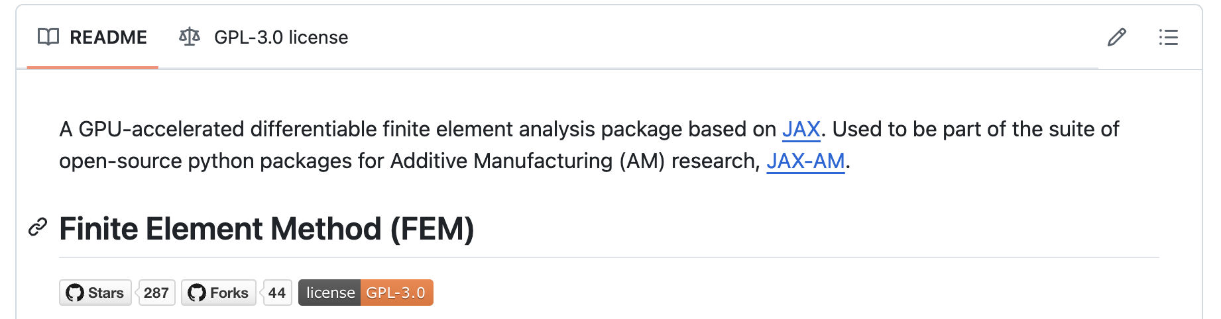


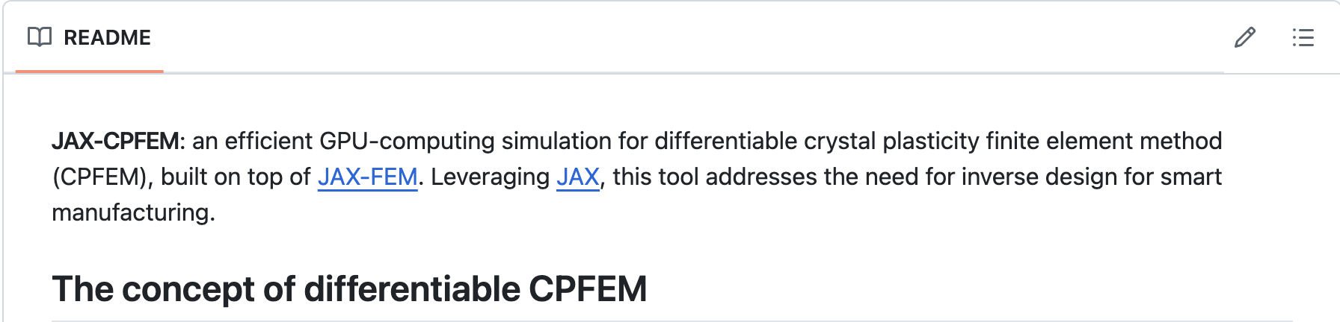
What is JAX-FEM and JAX-CPFEM
Based on JAX (by Google)
CPU/GPU compatible
~10× to 100× boost in performance from CPU to GPU
Implemented with pure Python
Just-in-time compilation
Fast developing and easy collaboration
Automatic linearization for nonlinear problems
Work directly with the weak form
Perform the linearization using AD
Allows end-to-end automatic differentiation (AD)
Gradient-based design and optimization
Full access to JAX machine learning functions
Initial version released by Google in 2018
JAX-FEM: A differentiable GPU-accelerated 3D finite element solver [1]
GitHub page
Launched in late 2024
JAX-CPFEM: Efficient differentiable GPU-computing [2]
[1] Xue, Tianju, et al., Computer Physics Communications, 291 (2023): 108802.
[2] Hu, F., Niezgoda, S., Xue, T., & Cao, J. (2025). npj Computational Materials, 11(1), 46.
Notes:
we would like to use JAX
The package that we develop for this is called JAX-FEM.
This software is differentiable. We are using the JAX, which is a Google library for the user for Machine learning.
Automatic differentiation
Push this next level

Slide 8
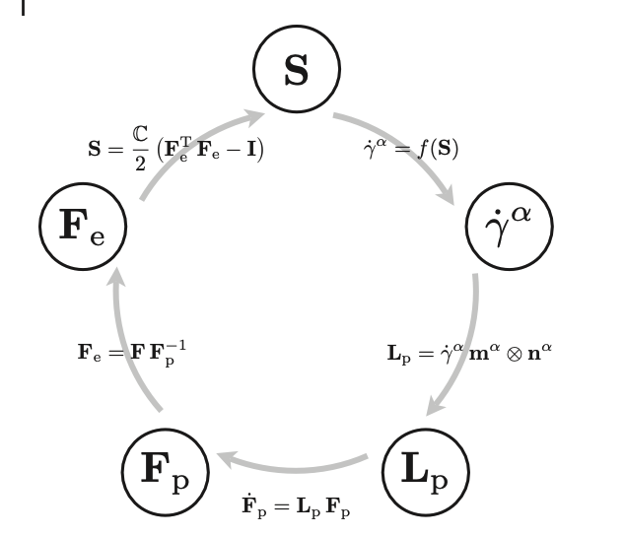
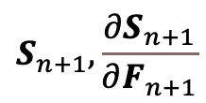


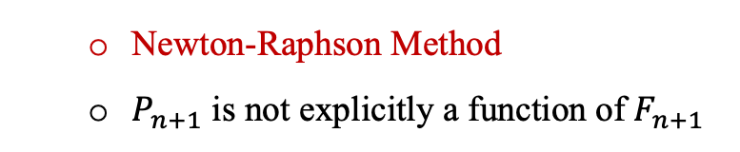
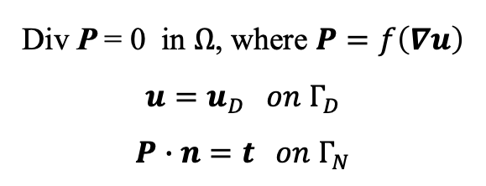

Char. 1: AutoDiff of constitutive laws
Constitutive Laws
$$R_{c}\left(F_{n+1},S_{n+1}\right)=0$$
$${ F}_{n+1}$$
Governing Equation
At (n+1) time step, mapping F_{n+1} to S_{n+1}
Newton-Raphson Method
Div P = 0 in $Ω$, where $P=f\left(∇u\right)$
$u=u_{D} on Γ_{D}$
$P∙n=t on Γ_{N}$
Second Piola-Kinchhoff
Stress
$$S_{n+1}, \frac{∂S_{n+1}}{∂F_{n+1}}$$
$$R\left(u_{n+1}\right)=0$$
Elastic Deformation
Gradient
Newton-Raphson Method
$P_{n+1}$ is not explicitly a function of $F_{n+1}$
Plastic Deformation
Gradient
Plastic Velocity
Gradient
Clockwise loop of calculations during stress determination [1]
[1] Roters, F. et al., Computational Materials Science, 2019. 158: p. 420-478.
Notes:
### Easy to use

Slide 9
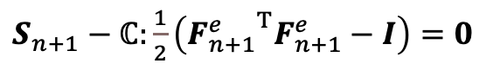
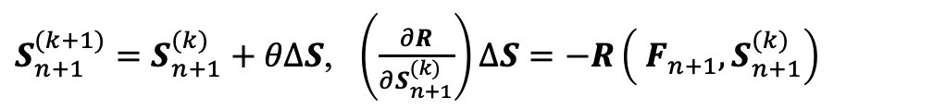
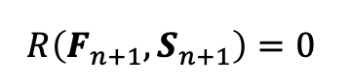
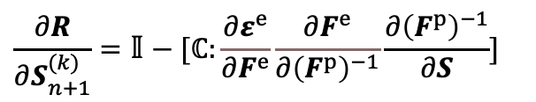
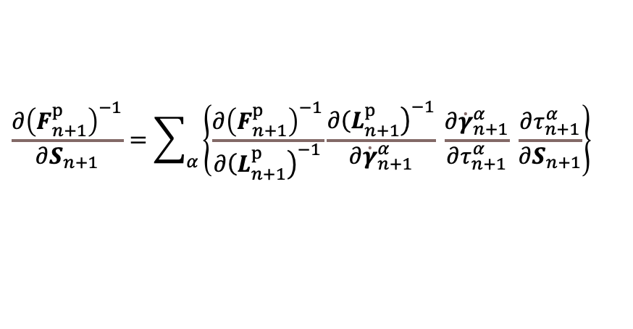
Char. 1
AutoDiff of constitutive law: jax.jacfwd
Constitutive Laws
$$R\left(F_{n+1},S_{n+1}\right)=0$$
$S_{n+1}−$ $ℂ:\frac{1}{2}\left({F_{n+1}^{e}}^{Τ}F_{n+1}^{e}−Ι\right)=0$
$$R_{c}\left(F_{n+1},S_{n+1}\right)=0$$
$S_{n+1}^{(k+1)}=S_{n+1}^{(k)}+θΔS$, $\left(\frac{∂R}{∂S_{n+1}^{(k)}}\right)ΔS=−R\left({ F}_{n+1},S_{n+1}^{(k)}\right)$
At (n+1) time step, mapping F_{n+1} to S_{n+1}
Newton-Raphson Method
$$\frac{∂R}{∂S_{n+1}^{(k)}}=𝕀−[ℂ:\frac{∂ε^{e}}{∂F^{e}}\frac{∂F^{e}}{∂{\left(F^{p}\right)}^{−1}}\frac{∂{\left(F^{p}\right)}^{−1}}{∂S}]$$
CP slip derivative [1]
Second Piola-Kinchhoff
Stress
$$\frac{∂{\left(F_{n+1}^{p}\right)}^{−1}}{∂S_{n+1}}=\sum_{α}{\left\{\frac{∂{\left(F_{n+1}^{p}\right)}^{−1}}{∂{\left.{\left(L\right.}_{n+1}^{p}\right)}^{−1}}\frac{∂{\left.{\left(L\right.}_{n+1}^{p}\right)}^{−1}}{∂{\dot{γ}}_{n+1}^{α}} \frac{∂{\dot{γ}}_{n+1}^{α}}{∂τ_{n+1}^{α}} \frac{∂τ_{n+1}^{α}}{∂S_{n+1}}\right\}}$$
Elastic Deformation
Gradient
Automatic Differentiation (AD) for Jacobian matrix:
Different constitutive laws
Different physics mechanisms
Whenever there is derivative to evaluate
Plastic Deformation
Gradient
Plastic Velocity
Gradient
Clockwise loop of calculations during stress determination [1]
[1] https://mooseframework.inl.gov/source/materials/crystal_plasticity/

Slide 10
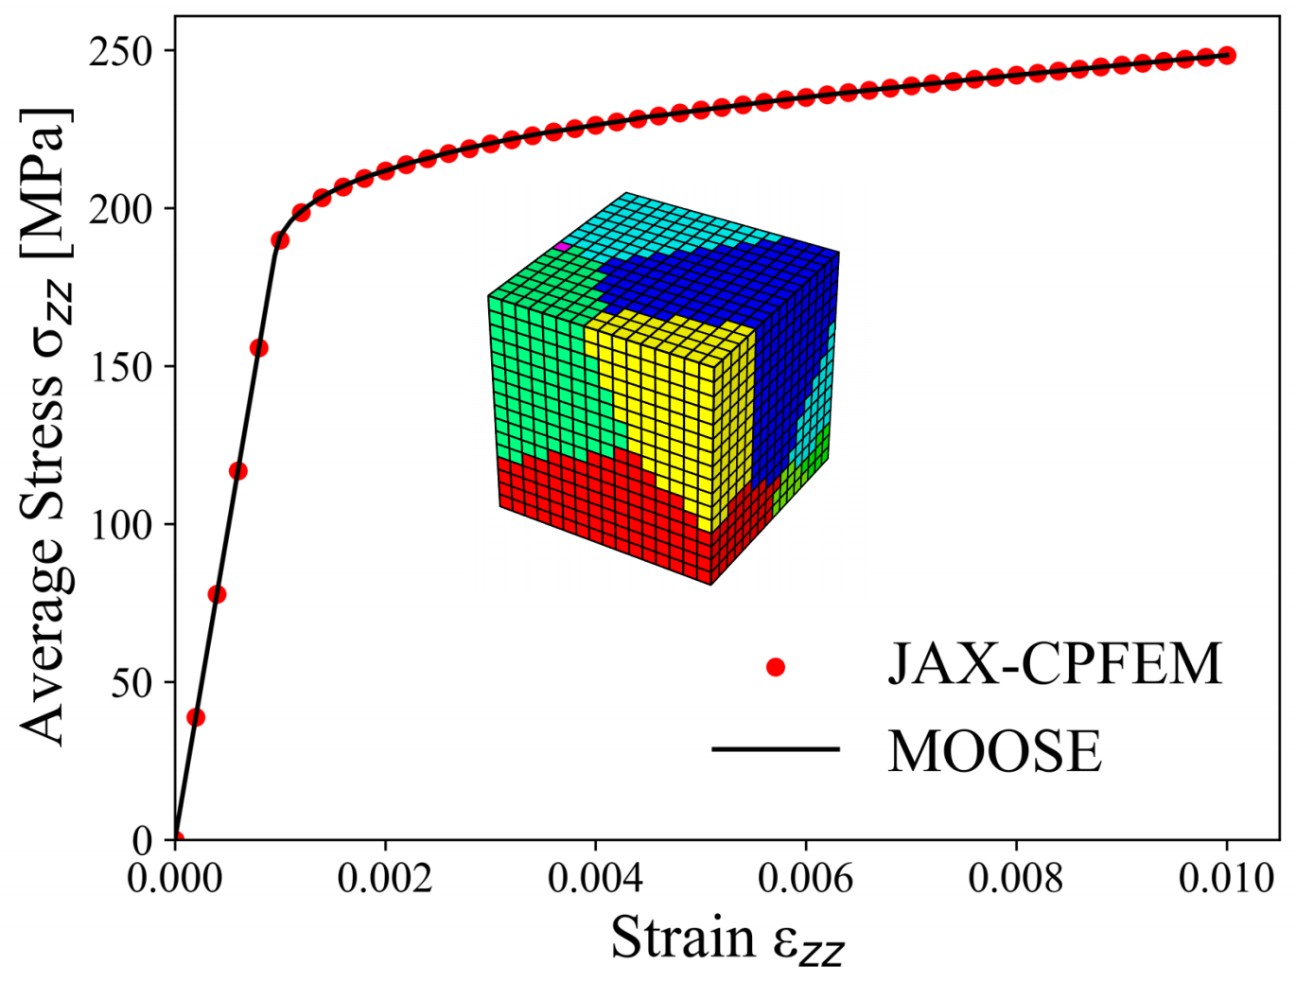
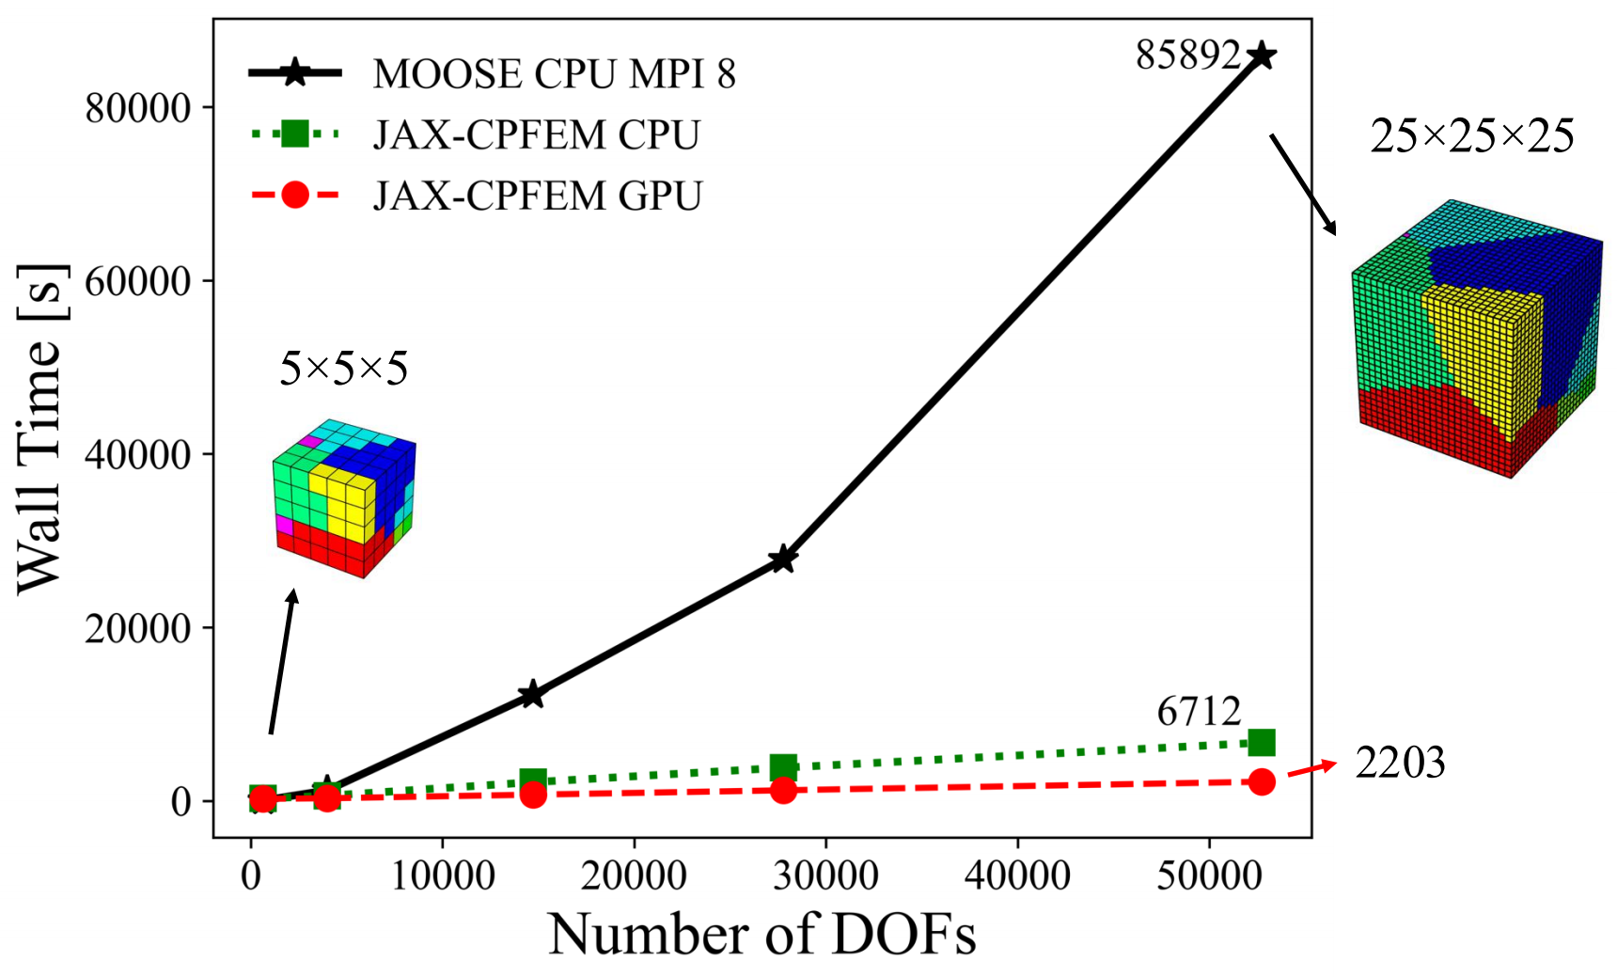
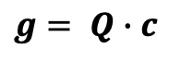
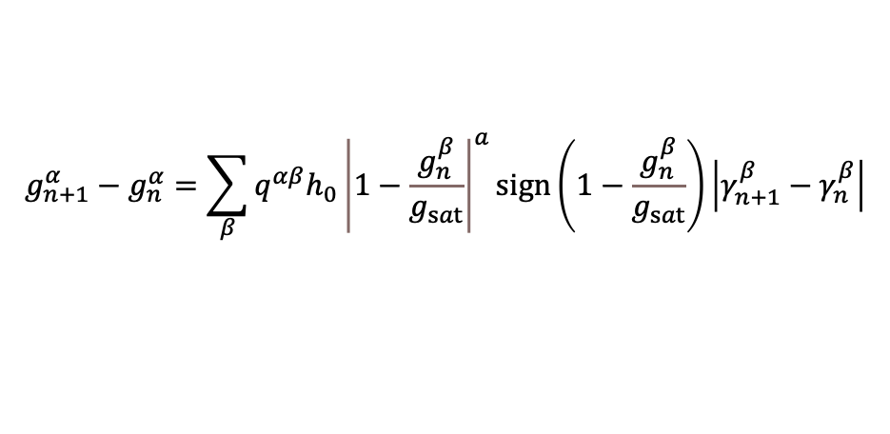
Char. 2: GPU-acceleration
CPU/GPU compatible:
Array programming – jax.vmap
Just-in-time compilation – jax.jit
Matrix formulation – constitutive laws
Slip resistance
$$g_{n+1}^{α}−g_{n}^{α}=\sum_{β}{q^{αβ}h_{0}{\left|1−\frac{g_{n}^{β}}{g_{sat}}\right|}^{a}sign\left(1−\frac{g_{n}^{β}}{g_{sat}}\right)}\left|γ_{n+1}^{β}−γ_{n}^{β}\right|$$
$$g= Q∙c$$
(~1d)
(~0.6 h)
[1] Hu, F., Niezgoda, S., Xue, T., & Cao, J. (2025). npj Computational Materials, 11(1), 46.
Notes:
We compare it with the another open source code MOOSE. It matched pretty well.
And the time that we have is lots of advantages when you have more degrees of freedom
So five by five by five, it is probably computational time very similar. But once you go beyond, more and more, as you can see, JAX-CPFEM is down here.
JAX-CPFEM (CPU / GPU) is 12.8× / 39.0× faster than MOOSE (CPU MPI 8) for the 52.7 thousand degree of freedoms problem [1]

Slide 11
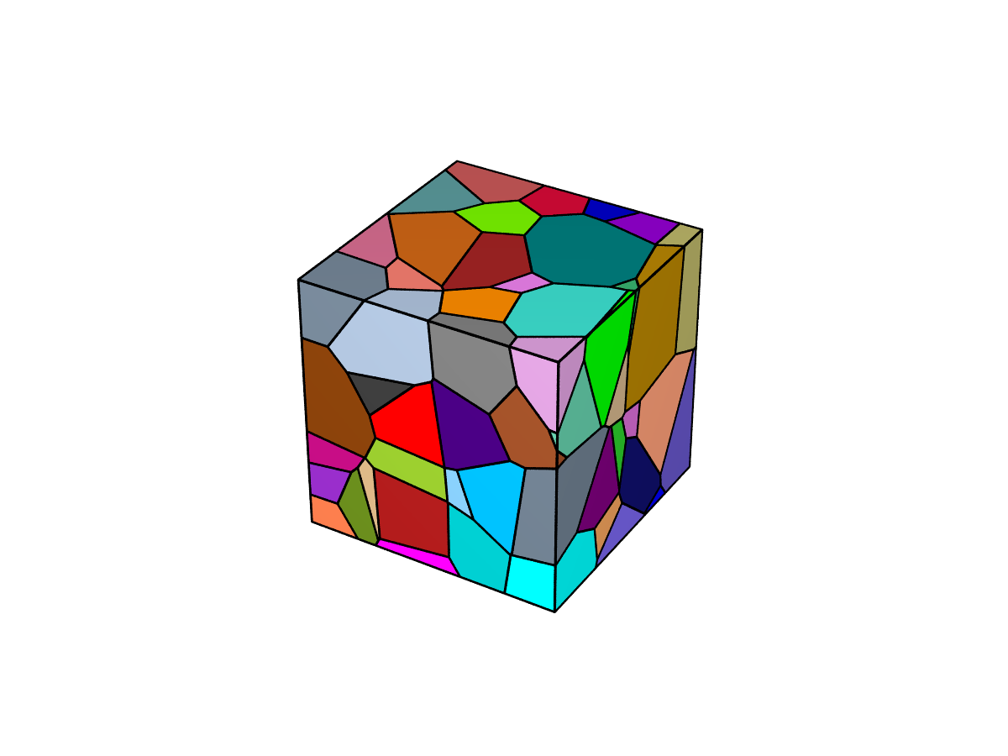
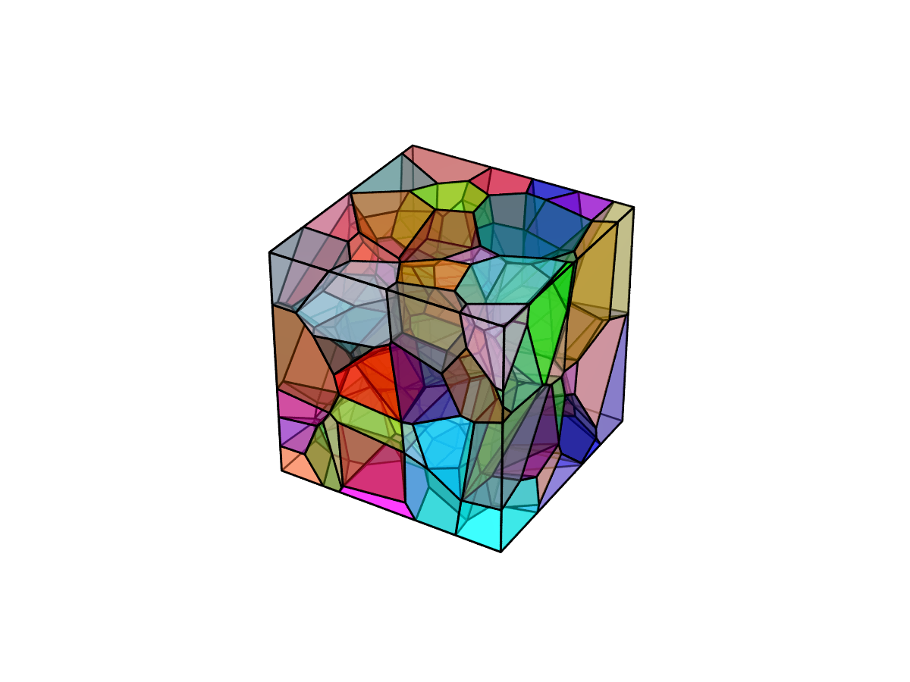
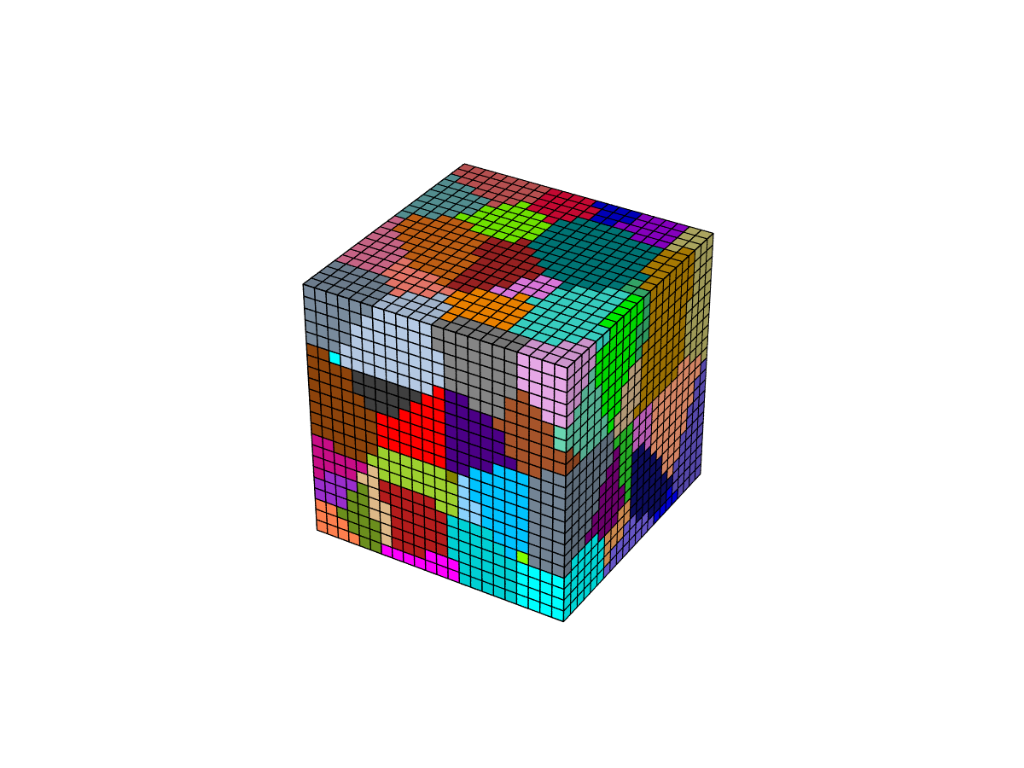
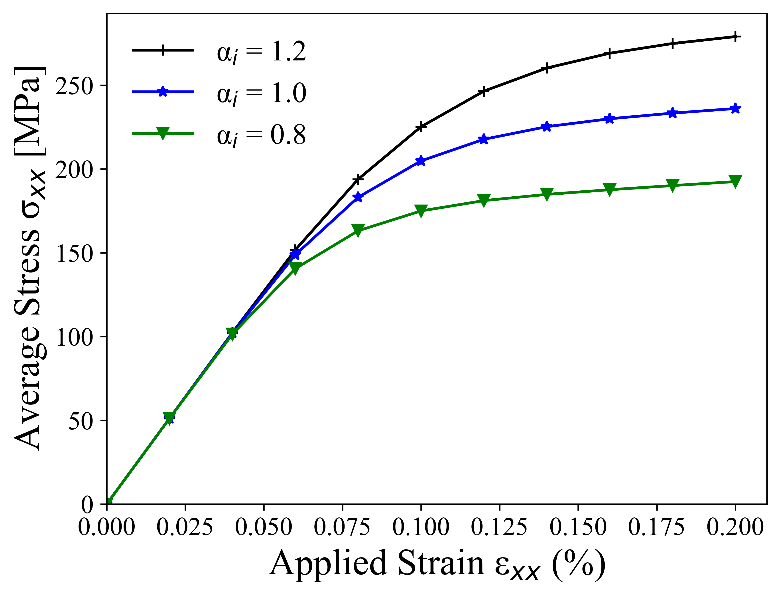
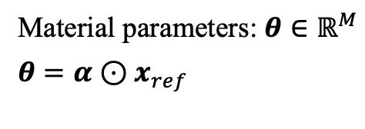
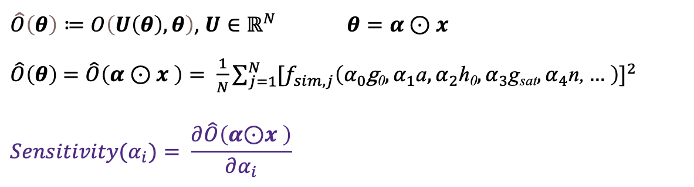
Char. 3: Automatic sensitivity
Ensured Grain Orientations – Copper (0.1mm) – 100 grains
Kalidindi’s constitutive model
g₀ gss_initial (60.8) Initial slip resistance
a gss_a (2.5) Hardening parameter
h₀ h (541.5) Hardening parameter
g_{sat} t_sat (109.8) Saturation slip resistance
n xm (0.1) Rate sensitivity exponent
Material parameters: $θ∈ℝ^{M}$
$$θ=α⊙x_{ref}$$
Effect of $θ_{i}$on $\hat{O}\left(θ\right)$ (${\overline{σ}}_{xx}$) at different stages $s_{j}$($j=0\sim N)$
$\hat{O}\left(θ\right)≔O\left(U\left(θ\right),θ\right)$, $U∈ℝ^{N}$ $θ=α⊙x$
$\hat{O}\left(θ\right)$ $=\hat{O}\left(α⊙x \right)= \frac{1}{N}\sum_{j=1}^{N}{{[f_{sim,j}\left(α_{0}\text{g}\text{0},α_{1}\text{a},α_{2}\text{h}\text{0},α_{3}\text{g}\text{sat},α_{4}\text{n}\text{,}… \right)]}^{2}}$
$$Sensitivity(α_{i})= \frac{∂\hat{O}\left(α\text{⊙}x \right)}{∂α_{i}}$$
AutoDiff & Implicit Diff.
Notes:
## Differentiable

Slide 12
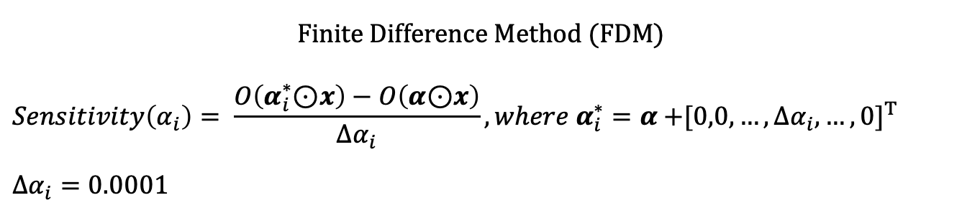
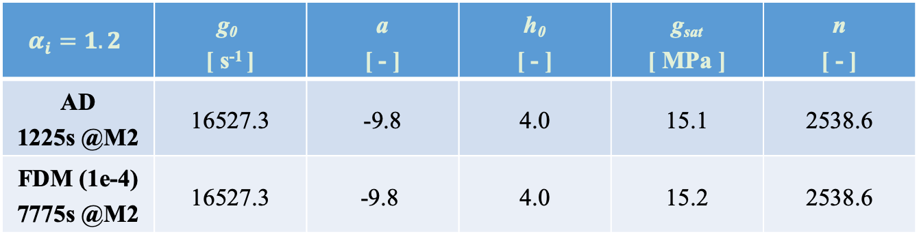
Char. 3: Automatic sensitivity
Finite Difference Method (FDM)
$$Sensitivity\left(α_{i}\right)= \frac{O\left(α_{i}^{∗}\text{⊙}x\right)−O\left(α\text{⊙}x\right)}{∆α_{i}}, where{ α}_{i}^{∗}=α{+[0,0,…,∆α_{i}, …,0]}^{T}$$
$$∆α_{i}=0.0001$$
$$α_{i}=1.2$$ | $$\text{g}\text{0}$$ [ s⁻¹ ] | a [ - ] | h₀ [ - ] | g_{sat} [ MPa ] | n [ - ]
AD 1225s @M2 | 16527.3 | -9.8 | 4.0 | 15.1 | 2538.6
FDM (1e-4) 7775s @M2 | 16527.3 | -9.8 | 4.0 | 15.2 | 2538.6
Note: 0.001%~0.3% difference between AD and FDM
Note: JAX-CPFEM: AD (CPU @ M2) is 6.3× faster than FDM (CPU @ M2)
[1] Fanglei Hu, et al., TMS Specialty Congress 2024

Slide 13
Brief summary of JAX-CPFEM
Three features of differential JAX-CPFEM
Calibration
GitHub page
AutoDiff of Constitutive Laws
Free to realize different deformation mechanics
Case-by-case Jacobian matrix
GPU-acceleration
Efficient solution to forward CPFEM
array programming style
matrix formulation
Automatic Sensitivity
Sensitivity analysis with respect to design parameters
Integrated with inverse design seamlessly
JAX-CPFEM
Material
Design
Process
Design
[1] Hu, F., Niezgoda, S., Xue, T., & Cao, J., to be submitted
[2] Hu, F., Niezgoda, S., Xue, T., & Cao, J. (2025). npj Computational Materials, 11(1), 46.
[3] Unpublished results
Notes:
Note: ～17 mins
We want to emphasize the following three features that differential JAX-CPFEM differ from other CPFEM software:
Automatic Constitutive Laws: Free to realize different deformation mechanics represented by constitutive materials laws by evaluating the case-by-case Jacobian matrix using automatic differentiation.
Automatic Sensitivity: Differential simulation for sensitivity analysis with respect to design parameters used in single crystal or polycrystal, which can be seamlessly integrated with inverse design.
GPU-acceleration: Efficient solution to forward CPFEM (involving complicated nonlinear relations) with GPU acceleration based on array programming style and matrix formulation.

Slide 14
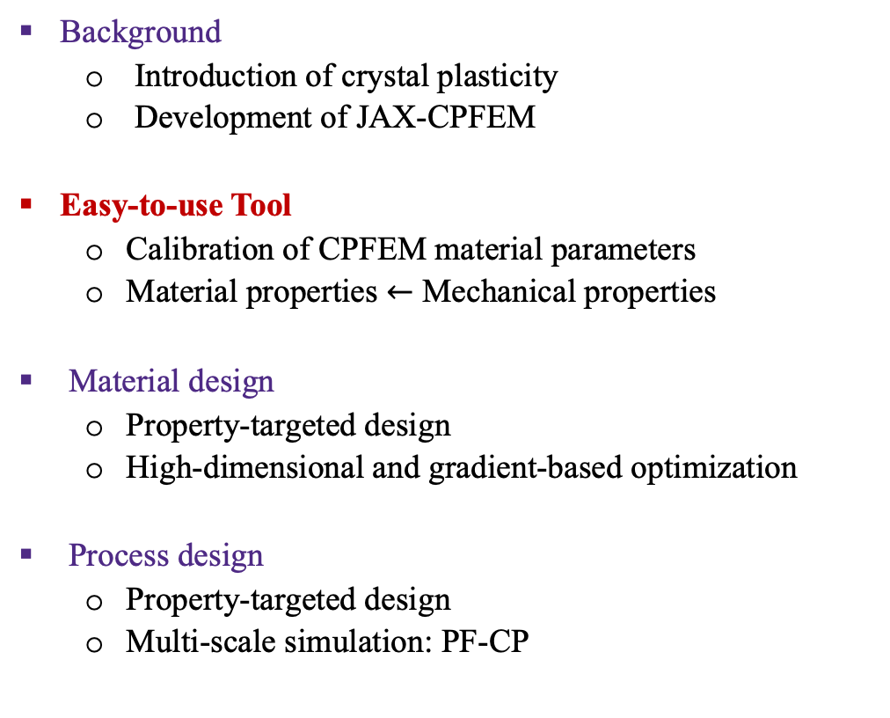
Outline
Background
Introduction of crystal plasticity
Development of JAX-CPFEM
Easy-to-use Tool
Calibration of CPFEM material parameters
Material properties $←$ Mechanical properties
Material design
Property-targeted design
High-dimensional and gradient-based optimization
Process design
Property-targeted design
Multi-scale simulation: PF-CP
Calibration
GitHub page
JAX-CPFEM
Material
Design
Process
Design
Notes:
Calibration of CPFEM material parameters by multi-objective optimization with AD‐based sensitivities

Slide 15
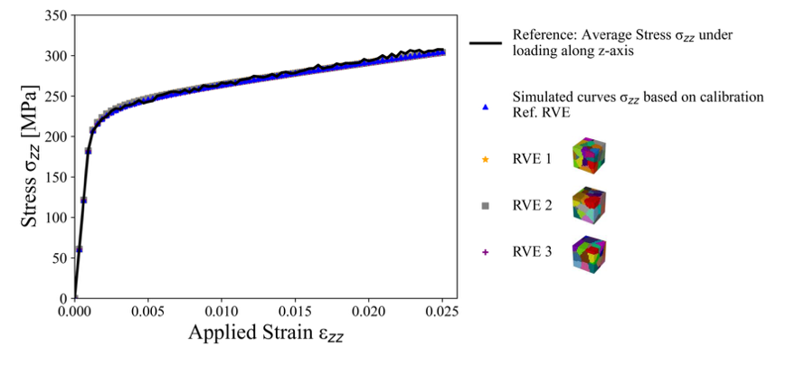
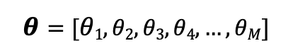
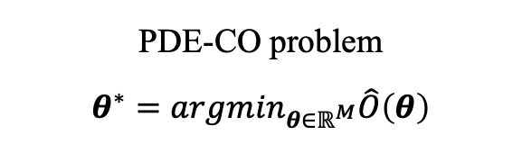
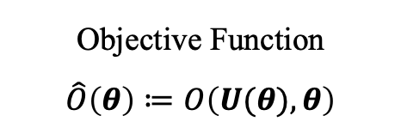
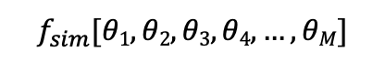
Calibration of material parameters
$$θ=[θ1,θ2,θ3,θ4, …,θM]$$
Forward Mode
$$f_{sim}[θ1,θ2,θ3,θ4, …,θM]$$
h₀ Hardening parameter
n Rate sensitivity exponent
g_{sat} Saturation slip resistance
……
Input Parameters
Crystal Plasticity
Finite Element Method
(CPFEM)
Output
Properties
Stress-Strain Curve
Yield Stress
Hardening Rate
……
“Back propagation” for inverse analysis
Minimize the misfit between the CPFEM simulations and experimental data
PDE-CO problem
$$θ^{∗}=arg\min_{θ∈ℝ^{M}}\hat{O}\left(θ\right)$$
Objective Function
$$\hat{O}\left(θ\right)≔O\left(U(θ),θ\right)$$
Notes:
Similar figures

Slide 16
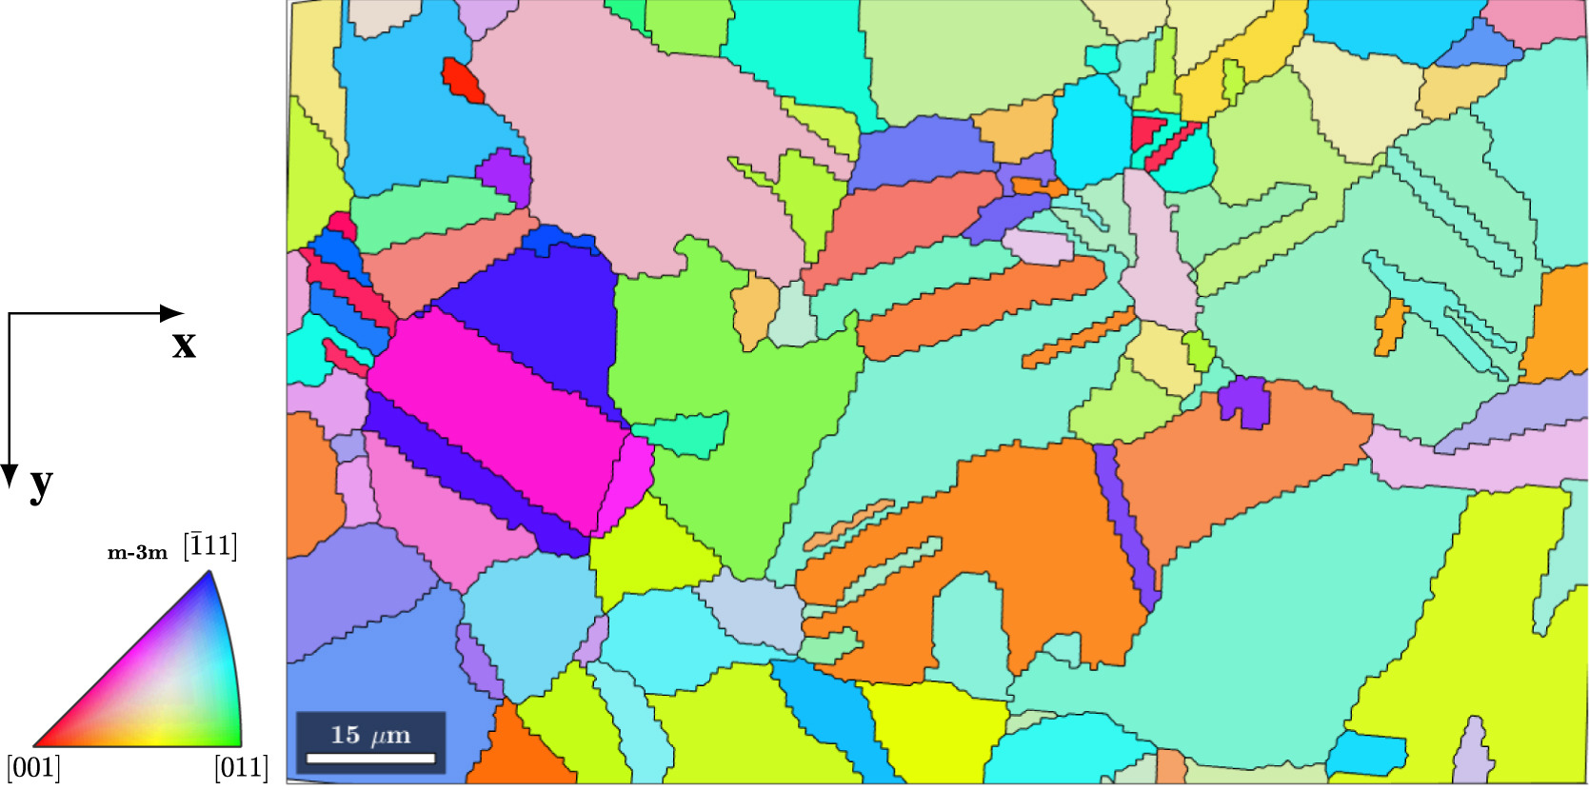
Calibration of material parameters
Aim：Get CPFEM constitutive parameters accurately and efficiently？
In-situ Mechanical Test / Characterization [1]
Actual properties of single crystals
Expensive & time-consuming
Trial-And-Error
Fitting of mechanical data
Fitting of microscopic material models
Gradient-Free (GF) Optimization
Bayesian optimization [2][3]
Genetic algorithm [4]
Nelder-Mead algorithm [5]
Reconstructed grains from EBSD characterization
Gradient-Based (GB) inverse optimization？
[1] Depriester et al., International Journal of Plasticity, 2023. 168: p. 103695. [2] A. Tran et al., Computational Mechanics, 2023. 1-14.
[3] J. Kuhn et al., Optimization and Engineering, 2021. 1-35. [4] K. Sedighiani, et al., Mechanics of Materials, 2022. 104117.
[5] Chakraborty et al., European Journal of Mechanics-A/Solids, 2017. 66: p. 114-124
Notes:
## Backup3 calibration pipeline
This is where the JAX-CPFEM come in.
Nano-indetor

Slide 17
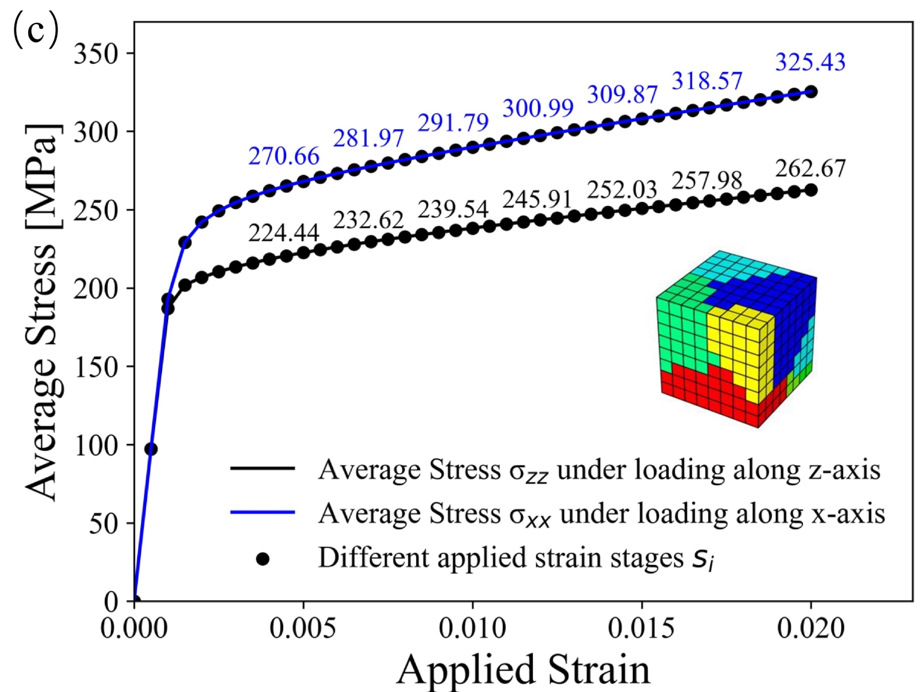
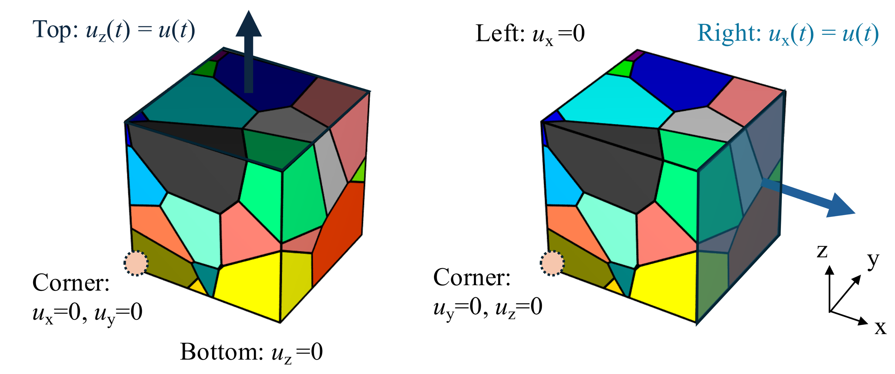
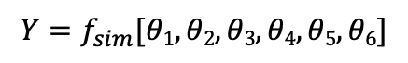

Case study: reference
Forward Mode
Input Parameters
CPFEM
Output
Properties
Material Parameters [1]
Stress-Stain Curve
$$θ=[θ1,θ2,θ3,θ4,θ5,θ6]$$
$$Y=f_{sim}[θ1,θ2,θ3,θ4,θ5,θ6]$$
Reference result
Gradient backpropagation
Kalidindi’s self and latent hardening laws
Scenario 1
Scenario 2
(1) g₀ (90.0) Initial slip resistance
(2) a (8.0) Hardening parameter
(3) h₀ (392.977) Hardening parameter
(4) g_{sat} (7295.1754) Saturation slip resistance
(5) n (1.0/120.0) Rate sensitivity exponent
(6) r (1.0) Interaction coefficient
Loading along z-axis or x-axis
[1] Tran et al., 2023, AIAA SCITECH 2023 Forum.
Notes:
## Backup 3: GB calibration results - Dual phase P37

Slide 18





Case study: GB calibration results
$\min_{a∈ℝ^{M}}\hat{O}\left(α\text{⊙}x \right)$ $s.t. R\left(U,θ\right)=0$
Gradient-based Optimization
${\hat{O}}_{1}(θ)={\hat{O}}_{1}\left(α\text{⊙}x\right)=w_{1}×\frac{\sum_{i=1}^{N}{[{(y_{i}−f_{sim,i}(α\text{⊙}x))}^{2}]}}{\sum_{i=1}^{N}{[{y_{i}}^{2}]}}$.
$\frac{∂\hat{O}\left(a\text{⊙}x \right)}{∂α_{i}}$ -- verified.
L-BFGS-B algorithm [1] for Gradient-based optimization:
Bound-constrained minimization
SciPy package 1.11.1
Match
Objective values vs. No. of calls [2]
Stress-Strain curve before and after calibration [2]
[1] Byrd et al., SIAM Journal on Scientific and Statistical Computing, 1995.16 (5): 1190-1208.
[2] Hu, F., Niezgoda, S., Zha, R., Xue, T., & Cao, J., to be submitted
Notes:
## Backup 3: GB calibration results P36

Slide 19


Calibration: GB vs GF - Efficiency
Comparing Gradient-based and Gradient-free Optimizations [1]
Bayesian algorithm for gradient-free optimization
Same initial guess and guess range of parameter
Scikit-optimize package 0.9.0
Conclusions:
Approximately 7× fewer iterations
A 3× to 4× efficiency improvement
[1] Hu, F., Niezgoda, S., Zhou, R., Ryou K., Dunand D., Zha, R., Xue, T., & Cao, J., to be submitted
Notes:
Forward calls

Slide 20




Calibration: GB vs GF - Accuracy
Comparing Gradient-based and Gradient-free Optimizations [1]
Bayesian algorithm for gradient-free optimization
Same initial guess and guess range of parameter
Scikit-optimize package 0.9.0
Comparison between the reference result and calibrated results of single-crystal copper obtained from gradient-based and gradient-free optimizations (five tests).
[1] Hu, F., Niezgoda, S., Zhou, R., Ryou K., Dunand D., Zha, R., Xue, T., & Cao, J., to be submitted
Notes:
## Backup 4: GO scenario
matrics

Slide 21



Calibration
Application to Wrought IN625
Homogenized at 1150 $℃$ for 3 hours
Area-weighted mean grain size of 147$±$52 $μm$
Inverse pole figure (IPF) maps
Comparison between the experimental result and calibrated results
[1] Hu, F., Niezgoda, S., Zhou, R., Ryou K., Dunand D., Zha, R., Xue, T., & Cao, J., to be submitted
Notes:
## Backup 4: GO scenario ~23 min

Slide 22

Outline
Background
Introduction of crystal plasticity
Development of JAX-CPFEM
Easy-to-use Tool
Calibration of CPFEM material parameters
Material properties $←$ Mechanical properties
Material design
Property-targeted design
High-dimensional and gradient-based optimization
Process design
Property-targeted design
Multi-scale simulation: PF-CP
Calibration
JAX-CPFEM
Material
Design
Process
Design
Notes:
Case Study 1: Property-targeted microstructure/material design

Slide 23












Materials design
GitHub page
Launched in late 2024
Euler Angle $\left[α_{i}, β_{i},{ γ}_{i}\right]$ Z-Y-X
$$\min_{a∈ℝ^{M}}\hat{O}\left(θ\right)$$
$$\hat{O}\left(θ\right)=w×\sum_{i=1}^{n}{{\left(y_{i}−f_{sim,i}\left(θ\right)\right)}^{2}}$$
Initial Guess
Euler Angle $α_{i}$
Euler Angle $β_{i}$
Euler Angle${ γ}_{i}$
x
y
z
[111]
m-3m
[001]
[101]
Designed Results
[1] Hu, F., Niezgoda, S., Xue, T., & Cao, J. (2025). Efficient GPU-computing simulation platform JAX-CPFEM for differentiable crystal plasticity finite element method. npj Computational Materials, 11(1), 46.
Notes:
~1.18 hours (4231 secs) for 32 iterations on DM GPU @ RTX 8000. ~26min
Let’s see you know, I have the material and I really want to have certain yield stress and I also really want to have certain energy absorption capability.
This is where the desired stress-strain curve comes in. If you wan to have this one, the dotted one, what is the microstruture you need to give you that behavior, right? So you can start with Euler angle with very constant ones across this grid. And each one, if you do the inverse pole figure, which is here. And it’s a red line.
So the question is can we find out the microstructure that will give us this dotted line, which we basically use JAX-CPFEM and put the optimization, and after you run around 31 iterations. You can see that each cell at that block is actually giving you different phase. So it ends up with this final microstructure.

Slide 24

Outline
Background
Introduction of crystal plasticity
Development of JAX-CPFEM
Easy-to-use Tool
Calibration of CPFEM material parameters
Material properties $←$ Mechanical properties
Material design
Property-targeted design
High-dimensional and gradient-based optimization
Process design
Property-targeted design
Multi-scale simulation: PF-CP
Calibration
JAX-CPFEM
Material
Design
Process
Design
Notes:
Case Study 2: Process path design

Slide 25







Property-targeted process design
Input Parameters
Forward Mode
Cold Rolling Process
Time-dependent applied displacement
$$θ=[θ1,θ2,θ3,θ4, …,θt]$$
Crystal Plasticity
Finite Element Method
(CPFEM)
Output Properties
Mechanical Property
Stress/Strain status, Yield stress, …
$$f_{sim}[θ1,θ2, …,θt,α1,α2, …,αN]$$
Initial Microstructure
Grain size, Orientation distribution…
$$α=[α1,α2,α3,α4, …,αN]$$
“Back propagation” for inverse analysis
PDE-CO problem
Objective Function
$$θ^{∗}=arg\min_{θ∈ℝ^{M}}\hat{O}\left(θ\right)$$
$$\hat{O}\left(θ\right)≔O\left(U(θ),θ\right)$$
Multi-Path rolling
[1][2]
[1] Sedighiani, Karo, et al. Acta Materialia 237 (2022): 118167.
[2] Yilmaz, Fatih, et al. The International Journal of Advanced Manufacturing Technology (2025): 1-21.

Slide 26








Property-targeted process design
[1]
Input Parameters
Finite Element
Oriented Properties
$$X=[x]$$
$$Y=f[x]$$
Crystal Plasticity
Initial blank geometry
Initial microstructure
Manufacturing process
…
Mechanical Properties
Desired microstructure
…
Phase Field
Dislocation Dynamics
Molecular Dynamics
DFT
Some Applications:
Precipitation [2]
Martensite [3]
Grain Growth [4]
Dendritic Growth [5]
Fracture [6]
[1] Kovachki, Nikola, et al. Mechanics of Materials 165 (2022): 104156. [2] Han, Zhiqiang, et al. Computational Materials Science 101 (2015): 248-254.
[3] Yeddu, et al. Acta Materialia 102 (2016): 97-107. [4] Staublin, Philip, et al. Acta Materialia 237 (2022): 118169.
[5] Dantzig, J. A., et al. Metallurgical and Materials Transactions A 44 (2013): 5532-5543.
[6] Xue, Tianju, et al., Computer Methods in Applied Mechanics and Engineering 385 (2021): 114046.
Notes:
Version 2

Slide 27



Property-targeted process design
3D printing products
Highly Anisotropic
PF: Processing – Microstructure
Post-Processing of 3D printing products
Highly Anisotropic
CP: Microstructure – Property
CPFEM
Phase-field modeling of microstructure evolution during 3D printing [1][2]
Degrees of Freedom: 21³* 3 = 27,783 Dofs No of Grain: 19
Uniaxial tensile deformation of a 0.043³ mm³ 304 steel
[1] Choi, Jin Young, et al., Additive Manufacturing 79 (2024): 103938.
[2] Xue, Tianju, et al. npj Computational Materials 8.1 (2022): 201.
Notes:
[1] PF provides microstructure of 3D printing product, what is the post-processing?
[2] An inverse problem
Jin surrogate

Slide 28






Property-targeted process design
Biaxial tensile deformation of a 0.02 mm FCC polycrystal 304 steel
Design Space
Forward Mode
“Back propagation”
for inverse design?
u_{x} (t) u_{y} (t)
Apply strain that varies nonlinearly
with respect to time
Targeted mechanical properties vs. applied strain
along x-axis
Notes:
Cut off Case 1
Bai-axiail

Slide 29



Property-targeted process design
$\min_{θ∈ℝ^{M}} \hat{O}\left(θ\right), s.t. R\left(U,θ\right)=0$
L-BFGS-B gradient-based optimization
234 iterations
62.6h (GPU)
3,993 DoFs
102 Designed Variables
Objective values vs. No. of calls
Reference vs. Designed variables during iterations
[1] Unpublished results
Notes:
IF you want to have this kind of stress strain curve behavior, what is the loading pass?
You can do the inverse analysis, and then you can that you start this one and actually can calculate the strain path for you

Slide 30
Theme of Our Work
The central goal is to facilitate inverse design in manufacturing.
Multi-GPU/CPU version for large size problem
(~1 million DoF for a single GPU )
We are building a platform to do multi-physics and multi-scale simulation (computational material science).
Calibration
Differentiable
Tool
Material
Design
Process
Design
GitHub page
Notes:
1. Limitation of memory
2. Multi-physics
3. multi-scale – Phase transformation

Slide 31


Acknowledgements
We would like to acknowledge support from the Department of Defense Vannevar Bush Faculty Fellowship, USA N00014-19-1-2642, and from the NSF Engineering Research Center for Hybrid Autonomous Manufacturing Moving from Evolution to Revolution (ERC‐HAMMER) under Award Number EEC-2133630.
Notes:
Backup: Performance P33
Backup 1: Kalidindi’s constitutive law P34
Backup 2: Automatic sensitivity P35
Backup 3: GB calibration results P36
Backup 3: GB calibration results - Dual phase P37
Backup 4: AutoDiff of constitutive laws P38
Backup 5: Microstructure-targeted process design P39
Backup 7: Phase field model P45

Slide 32
Backup
Notes:
##

Slide 33
Backup: Performance
JAX-CPFEM (CPU)
2.3 GHz Intel(R) Xeon(R) W-2195 CPU (18 cores) with NVIDIA Quadro
RTX 8000 GPU (48 GB Graphics memory) on Ubuntu 20.04.5 LTS.
MOOSE (CPU MPI 8 cores)
2.3 GHz Intel(R) Xeon(R) W-2195 CPU (18 cores)
Hardware and operating system

Slide 34











Backup 1: Kalidindi’s constitutive law
Sum of contributions
from all slip systems
Plastic velocity gradient
Governing Equation
Momentum Balance
Div P = 0
u = u_{D}
P$∙$n = t
Constitutive Model
in $Ω$
on $Γ_{D}$
on $Γ_{N}$
Physics-based constitutive model
Phenomenological constitutive model
Kinematic Formalism
$\dot{γ^{α}}$ Slip rate for slip system
$\dot{g^{α}}$ Rate of slip resistance
P First Piola-Kirchhoff stress
S Second Piola-Kirchhoff stress
F Deformation Gradient
$\dot{γ_{0}}$ Reference slip rate
h₀ Hardening parameter
g_{sat} Saturation slip resistance …

Slide 35



Backup 2: Automatic sensitivity
Finite Difference Method (FDM)
$$Sensitivity\left(α_{i}\right)= \frac{O\left(α_{i}^{∗}\text{⊙}x\right)−O\left(α\text{⊙}x\right)}{∆α_{i}}, where{ α}_{i}^{∗}=α{+[0,0,…,∆α_{i}, …,0]}^{T}$$
$$α_{i}=1.0$$ | $$\dot{γ_{0}}$$ | a | h₀ | g_{sat} | n
AD | 24353.6 | -34.3 | 17.0 | 52.8 | 4334.4
FDM | 24352.8 | -34.2 | 17.0 | 52.9 | 4334.4
$$α_{i}=1.2$$ | $$\dot{γ_{0}}$$ | a | h₀ | g_{sat} | n
AD 1225s (M2) | 16527.3 | -9.8 | 4.0 | 15.1 | 2538.6
FDM (1e-4) 7775s (M2) | 16527.3 | -9.8 | 4.0 | 15.2 | 2538.6
Note: 0.001%~0.3% difference between AD and FDM
Note: JAX-CPFEM: AD (CPU @ M2) is 6.3× faster than FDM (CPU @ M2)
[1] Fanglei Hu, et al., TMS Specialty Congress 2024
Notes:
Box for time
Units
Incre.
Just 1 as example
Put the time out

Slide 36



Backup 3: GB calibration results
Ref. value:$θ_{i}^{ref}={a_{i}^{ref}x}_{i}$;
Calib. value:${ θ}_{i}^{cal}={a_{i}^{cal}x}_{i}$;
$Difference= \frac{\left|Reference value−Calibrated value\right|}{Reference value}$.
Gradient-based Optimization
Ill-posed problem:
Close to their reference values within 8% difference (Acceptable)
Material Parameters |  | Misfit between stress values: ${\hat{O}}_{1}$
Initial slip resistance g₀ [MPa] | Ref. value | 1.0 $×$90.0
 | Calib. value | 0.997898 $×$90.0
 | Diff. | 0.210%
Hardening parameter a | Ref. value | 1.0 $×$8.0
 | Calib. value | 2.209654 $×$8.0
 | Diff. | 120.965%
Hardening parameter h₀ | Ref. value | 1.0 $×$392.9772
 | Calib. value | 1.066548 $×$392.9772
 | Diff. | 6.655%
Material Parameters |  | Misfit between stress values: ${\hat{O}}_{1}$
Saturation slip resistance g_{sat} [MPa] | Ref. value | 1.0 $×$ 7295.1754
 | Calib. value | 1.053586 $×$ 7295.1754
 | Diff. | 5.359%
Rate sensitivity exponent n | Ref. value | 1.0 $×$ (1.0/120.0)
 | Calib. value | 1.040702 $×$ (1.0/120.0)
 | Diff. | 4.070%
Interaction coefficient r | Ref. value | 1.0 $×$1.0
 | Calib. value | 1.066548 $×$1.0
 | Diff. | 6.655%

